Slide 1
KSI
DATA
Research
Module #01
History of SQL language
Understanding SQL Server Connection with different Services
Familiarization and setup SQL Server Tools
How to Create a Project and save Files
How to save code in any folder, under project and server-side
Use of SQL Server Configuration Manager
Create and Setup database / Tables with code and without code
Understand System database (master …….)
Restore AdventureWorks and AdventureWorksDW database
Download resource for Practice ( HR Schema database)
Fetch data from employee tables (slicing and dicing data)
What is Schema?
Import and Export data ( .csv or .xls files)
SQL Data Types ( int, varchar() …..)

Slide 2
Familiarization SQL Server
Understanding SQL Server Connection with different Services
Window Authentication (computer name, (local),.)
SQL Server Authentication
Connection to different computer
Different Services connections
Azure connection
Familiarization and setup of SQL Server Tools
Default Setting
Line Number
Toolbar / Manu Bar
Comment out
Uncomment
Configure Explorer
Size of the fonts
Execute/ F5
Numbers of New Queries Page
Console(Results, Message)
Available database
When to highlight code
or not highlight code

Slide 3
Familiarization SQL Server
How to Create a Project and save Files
Miscellaneour Files
Solution Explorer
Project Creation
Use of SQL Server Configuration Manager
SQL Server Configuration Manager is a tool to manage the services associated with
SQL Server, to configure the network protocols used by SQL Server, and to manage
the network connectivity configuration from SQL Server client computers.
Create and Setup database/Tables with code and without code
Create database with code
Create database without code
Availabe databse with/without code
Create table with/without code
Code are not case Sensitive
database/table/column naming

Slide 4
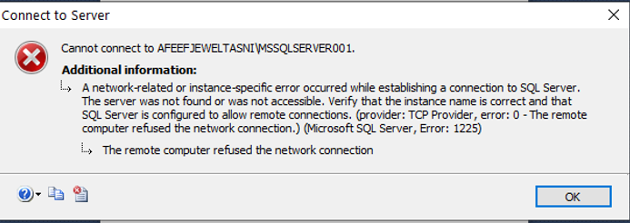
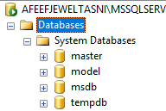
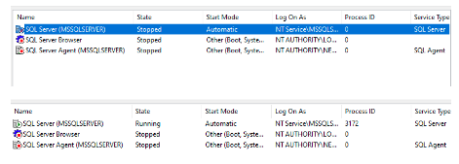
Fail to connect SQL Server.
Master – Information about all the database going to be in this server, SQL server configuration, login information.
Model – is a template database, when new database is create, the contents of the Model database are copies to the new database. Like table, view so on.
Msdb – MSdb stores all sort of data , such as backup, restore history, tuning advisor data, SQL agent job history so on.
Tempdb – Tempdb is a system database. SQL server used as a store temporary tables, Index
Right Click Start (Window) > Click Computer Management> Open or extended Service and Application > Open or extended SQL Server Configuration Manager. > Click SQL Server Services
IF SQL Server State(MSSQLSERVER) is showing Stopped, Highlight the SQL Server (MSSQLSERVER) , right click and click start. State should show Running.

Slide 5
Database, Table, Insert Data
Create a table in a database
Create database graphically and using a Query
(Right click database, database name, OK)
USE <database>
GO
(Create database <database name>)
Database create two files
Create table < Table_Name>
(
Id int,
Name varchar(200),
Salary money,
Gender char(1)
)
data files (.MDF file)
and transaction log file( .LDF file)
-allows you to perform “point in time” restores if you have system failures.
Where you can see data files??
Insert data into the table
C:\Program Files\Microsoft SQL Server\MSSQL12.MSSQLSERVER\MSSQL\DATA
-------Drop database < database name>
Insert into <table_name> values ( 1, ‘ABC’, 2000, ‘M’)
Insert into <table_name> values ( 2, ‘ABC’, 2000, ‘M’)
Learn Queries from the SMALL tables.
1) Create a new Project “MyLearingProject” and new files “MySQLtable”
2) Create database name "PEOPLE“ under new files “MySQLtable”
3) Write a SQL statement to create a simple table "TBLpeople" including columns people_id, lastName,
address, Gender and salary ( for numbers use data type INT and for characters use Varchar(100)) data type.
4) Write a SQL statement Insert new records (with your choice) in a "TBLpeople" table. (In two ways Specifying
the column Name and without specifying the columns Name optional)
Home Work: 01

Slide 6
Table, Insert Data, Basic Queries
create table emp
(
emp_ID int,
Name varchar(10),
Job_title varchar(9),
hire_date date,
salary int,
commission int,
deptno int,
)
insert into emp values(107, 'KING', 'PRESIDENT','1-11-1981',5000, null, 10 )
insert into emp values(105, 'BLAKE', 'MANAGER', '1-5-1981', 2850, null, 30 )
insert into emp values(106, 'CLARK', 'MANAGER', '9-6-1981',2450, null, 10)
insert into emp values(103, 'JONES', 'MANAGER', '2-4-1981',2975, null, 20)
insert into emp values(113, 'SCOTT', 'ANALYST', '1-7-87',3000, null, 20)
insert into emp values(111, 'FORD', 'ANALYST', '3-12-1981',4000, null, 20 )
insert into emp values(100, 'SMITH', 'CLERK', '1-12-1980',800, null, 20)
insert into emp values(101, 'ALLEN', 'SALESMAN', '2-2-1981',1600, 300, 30)
insert into emp values(102, 'WARD', 'SALESMAN', '3-2-1981',1250, 500, 30)
insert into emp values(104, 'MARTIN', 'SALESMAN', '8-9-1981',1250, 1400, 30)
insert into emp values(108, 'TURNER', 'SALESMAN', '8-7-1981',1500, 0, 30)
insert into emp values(109, 'ADAMS', 'CLERK', '3-JUL-87',1100, null, 20)
insert into emp values(110, 'JAMES', 'CLERK', '3-12-1981',950, null, 30)
insert into emp values(112, 'MILLER', 'CLERK','2-1-1982',1300, null, 10)
Learn to use
Clouse: Select, from, where, in, between, and , on, order by, =, >=, <=, <>,!=,
Distinct, top, like, Elias, is null, is not null

Slide 7
1-3
Fetch Data From Employee Table
Codes are not case sensitive
1) Fetch all data from the employee table.
2) Retrieve the top ten rows from the employee table.
3) Fetch the last name, job ID, and salary from the employee table.
4) Fetch the first two rows from the employee table.
5) Fetch all information for the employee 'King (last name)'.
6) Assign aliases for Employee ID, Last Name, and salary columns, and display results.
7) Fetch last name 'Chen', 'Austin', and 'King’ using columns employee ID, last name, and salary.
8) Retrieve employee data between employee id 100 and 105.
9) Fetch names using the like operator(following a, b, c)
a) People whose first name starts with 'Al’
b) People whose first name ends with 'Al’
c) Find people whose first name will have ‘am'
10) Fetch employees first name with a salary of more than 16000 dollars.
11) Retrieve the first names of employees whose salaries are $5,000 or less.
12) Retrieve the first names of employees whose salaries are greater than 8000 and less than 9000.
13) Retrieve employee data while excluding salary value 8000.
14) Fetch unique jobs ID from the employee table.
15) Fetch data and show the difference uses of AND / OR operators in a Where Clouse.
16) Fetch employee table sorted by salary in a descending and Ascending order.
17) Fetch the last two rows from the employee table.
18) Fetch data where employees get a commission NULL
19) Fetch data where employees get a commission ZERO
Home Work 02
SQL Syntax is:
SELECT <column_name>
FROM <table_name>
WHERE <condition>

Slide 8

What is Schema?
1-3
What is Schema?
Working with unknown value.
Schema: A schema is a container for database objects
(such as tables, views, stored procedures, etc.).
It helps to logically organize these objects and serves as a
namespace to avoid naming conflicts.
SQL Server uses NULL to make missing values.
A Null is neither TRUE or FALSE but it is make for UNKNOWN. NULL values as part of table is not good. Avoid storing NULL value, instead replace with DEFAULT value.
Schema is mainly used to manage several logical entities in one physical database.
Schemas offer a convenient way to separate database users from database object owners.(dbo) (divided into database tables in the case of relational databases).
–--go to AdventureWork 2014 or 2019 database
-- ---Example (HR, Person, Production, Purchase, Sale so on)
How to use many different database in a single Queries ?
By using the full path of the tables
While joining the tables.
Schema of the table write sp_help <table Name>
Insert data graphically and using a query.
Logical Order

Slide 9
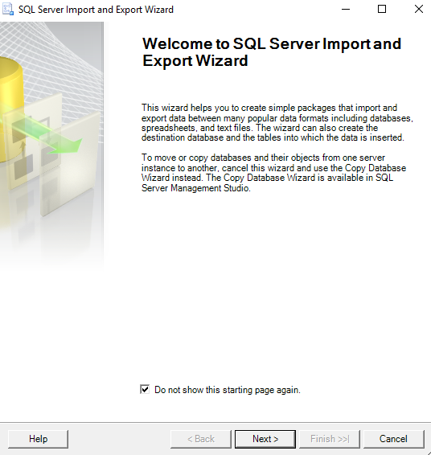
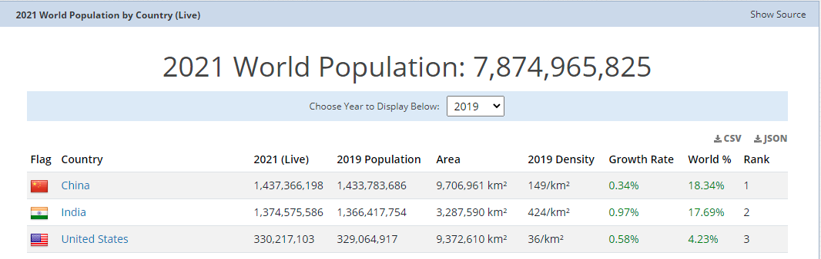
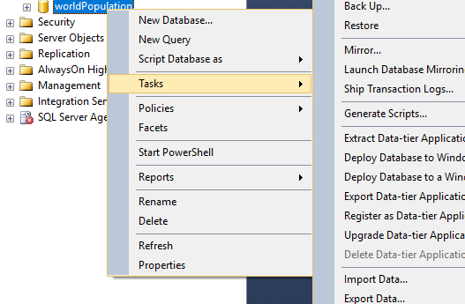
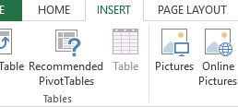
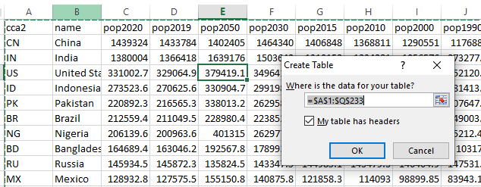
Data Export Import
1-4
. CSV files
. Xls files
Go to following Url
https://worldpopulationreview.com/
Go next > Choose Data Source (Microsoft excel) > Browse Excel File path (wp.xls) > next > Choose Destination ( SQL Server NativeClient 11.0 > Database WorldPopulation > Next > click excel Sheet
> Next > Run immediately , Next > Finished
Scroll down and click csv as shown bellow
Download
Place your cursor inside the table any place > Click insert > click table
> Click OK
Save the files on your desktop
as a WP.xls
Create a database worldPopulation > right Click wp database >
Tasks > click import Data

Slide 10
Fetch Data From World Population Table
--Q1: List out the country name, and the population for 2022 and 2023 from the world Population
--table, rename (your choice) the columns for 2022 and 2033 population columns
--Q2: List out all the country whose name starts with “B”
--Q3: List out the top ten countries in order by max population 2022
--Q4: List all the countries their rank between 1 and 15
--Q5: Fetch all countries with less than one growth rate.
--Q6: List out all the countries whose name end with “a” and the Population
------is more than Billions
--Q7: How many people live per square kilometer in China, India, Bangladesh, USA, and Canada
Home Work 03

Slide 11
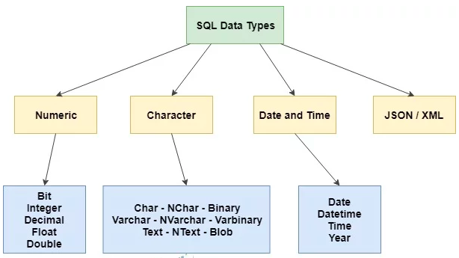
SQL Data Types
1-5
SQL developer must decide what type of data that will be stored inside each column when creating a table.
Numbers of characters use
In data type.
Char to char(8000)
Varchar to varchar(8000)
Varchar(max)
nvarchar to nvarchar(4000)
Create small tamp
table, show datatype
Numeric Data
Tinyint(1 byte) – 0 to 255
Smallint (2 bytes) –32,768 to 32767
Int ( 4 bytes)
Bigint (8 bytes)
Decimal or Number (8 Bytes)
Waste space
Unicode and Non Unicode
Unicode ---Universal supported data, when data use Globally ( All culture “N” National language) --- 2 byte = 1 character
Non-Unicode --- Non Universal supported data, When data use locally ( only English culture non National Language) -- 1 byte = 1 character
(( 1 bit means 0 or 1, 8 bit make one byte. 0 ,1 = 2⁸ = 256 character can be use like 1,2, @, <, >, [, (, so on . gigabyte is eight times bigger than one gigabit.))

